Slide 1
HKUST Business School
Apr 2025

Slide 2
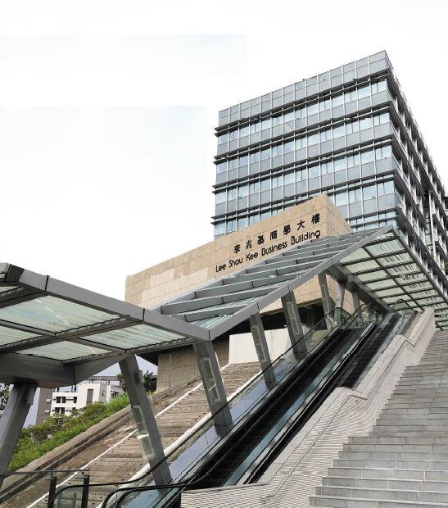
Driven by a commitment to innovation and excellence, the School sets its vision to become a top-tier business school in the world, with three key missions:
Vision
We are committed to becoming a top-tier business school in the world
MISSION
To advance global business knowledge
To develop business leaders in Asia for the world
To contribute to the economic and social advancements of the region

Slide 3




The School has established four values that exemplify its core essence – World Class in Asia:
core values
Achieve World Class Quality
Embrace Entrepreneurial &
Innovative Spirit
We are uncompromising in our drive to deliver world-class research and education
We embrace an entrepreneurial spirit that stimulates innovation, drives productivity and energizes our commitment to learn and grow
Foster Caring Attitude
Make Positive Impact
We take an active interest in and show genuine concern for the communities we serve and the world we live
Our faculty, students and graduates strive to make a positive impact on business and society

Slide 4





HKUST
World No.1
Young University Rankings
Times Higher Education (2018-2020)
HKUST Business School Research
Asia Pacific No.1
University of Texas at Dallas —
Top 100 Worldwide Business School
Research Rankings (2005-2023)
Kellogg-HKUST Executive MBA
World No.1 for 12 times
Financial Times (2007, 2009-2013, 2016-2018, 2020, 2022- 2023)
MSc in Finance
Asia Pacific No.1
Quacquarelli Symonds (2018-2022)
MSc in Global Operations
Asia Pacific No.1
Quacquarelli Symonds (2021-2023)
MBA
Asia Pacific No.1
Bloomberg Businessweek (2023-2024, 2024-2025)
World Top 20 for 13 times
Financial Times (2008-2020)
International Rankings
Recognition testifies our efforts dedicated to education and research
Notes:
HKUST and its Business School have risen to international prominence and gained prestigious recognition.

Slide 5


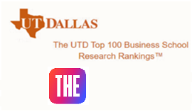
World Class Recognition
Worldwide accreditation
One of the first Asian business schools accredited by both the Association to Advance Collegiate Schools of Business (AACSB) and European Quality Improvement System (EQUIS)
High Quality Research
Asia No.1 (2005-2023) by University of Texas at Dallas Worldwide Business School Research Rankings
No.1 in University Employability in Hong Kong by Times Higher Education Global University Employability Rankings 2025
No.1 in Business & Economics Subject Amongst Universities in Hong Kong by Times Higher Education World University Rankings 2024

Slide 6
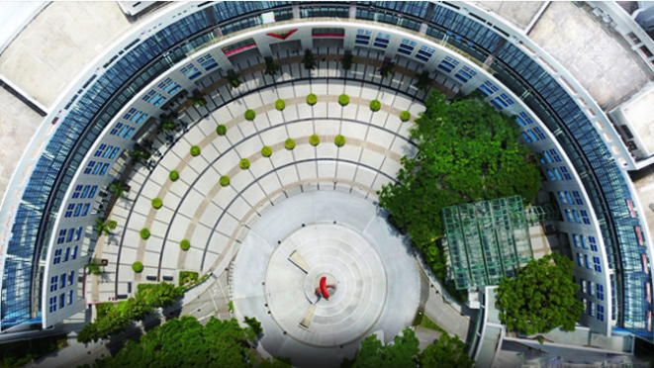
About the School
Since our establishment in 1991, our six departments strive to provide first-rate business education to our highly diverse and high-caliber students, encompassing:
Accounting
Economics
Finance
Information Systems, Business Statistics & Operations Management
Management
Marketing

Slide 7
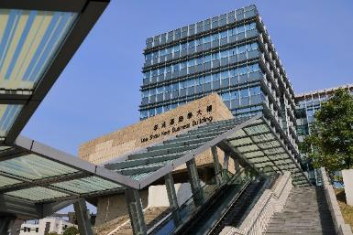
A Full Range of Program Offerings
Master of Science (MSc)
MSc in Business Analytics (Full-time/ Part-time)
MSc in Economics (Full-time)
MSc in Finance (Full-time/ Part-time)
MSc in Financial Technology (Full-time/ Part-time)
HKUST-NYU Stern MS in Global Finance* (Part-time)
MSc in Information Systems Management (Full-time/ Part-time)
MSc in International Management with CEMS: HKUST-Yale/ HKUST-FGV EAESP / HEC Paris-HKUST Double Degree options (Full-time)
Doctor of Business Administration (DBA)
Bilingual Doctor of Business Administration
MSc in Accounting (Full-time)
PhD/MPhil
MSc in Marketing (Full-time)
MSc in Global Operations: HKUST-Yale/ HKUST-FGV EAESP Double Degree options (Full-time)
MSc in Family Office and Family Business (Full-time/ Part-time)
MSc in Information and Cyber Security Management (Full-time/ Part-time)
Undergraduate
11 BBA and BSc programs, 7 joint school/ interdisciplinary programs/ dual degree (Government-funded)
MBA
Full-time MBA
World Bachelor in Business* (Self-financed)
Part-time MBA (Weekly Mode)
Executive MBA (EMBA)
Kellogg-HKUST Executive MBA*
HKUST EMBA for Chinese Executives
Digital MBA for Global Leaders (Part-time)
Open Programs
Company Programs
Non-degree Executive Programs
Part-time MBA (Bi-weekly Mode)
Accounting, Economics, Finance, Information Systems, Business Statistics, Management, Marketing, and Operations Management
*According to the Non-local Higher and Professional Education (Regulation) Ordinance, this program is an exempted course. It is a matter of discretion for individual employers to recognize any qualification to which this course may lead.

Slide 8
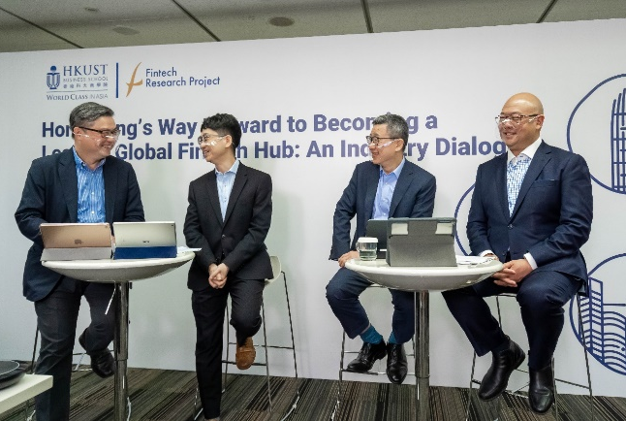
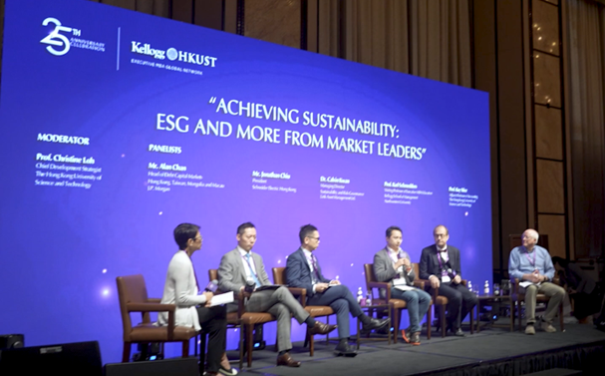
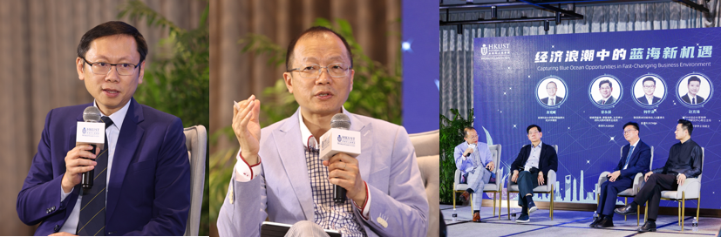
Research Powerhouse
Research Centers
Center for Business and Social Analytics
Center for Business Strategy and Innovation
Center for Economic Policy
Center for Investing
Center for Securities Analysis with Financial Technology
Roger King Center for Asian Family Business and Family Office
Thompson Center for Business Case Studies
HKUST Institute for Financial Research
HKUST Li & Fung Supply Chain Institute
Research Teams
Fintech Research Project Team
Green Finance Research Project Team
Technology Innovation, Consultancy, and Strategy Team
Education Centers
Center for Business Education

Slide 9

International Character with Asian Focus
Academic Research and Knowledge Transfer
Curriculum/ Course Content
International Composition of Faculty and Students
International Partnership

Slide 10
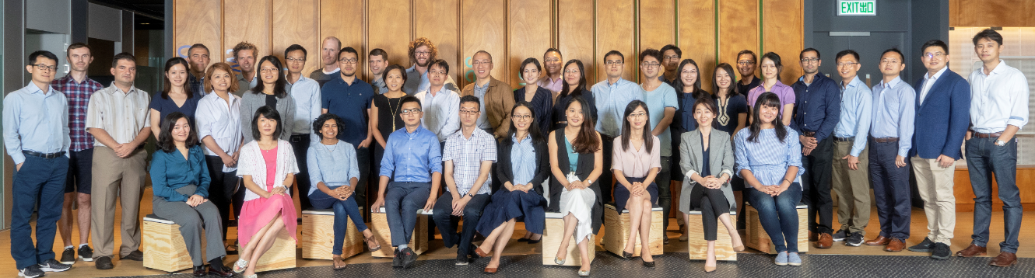
International Faculty
160+
Faculty
25+
Nationalities
Our strong faculty composition is among the most international

Slide 11
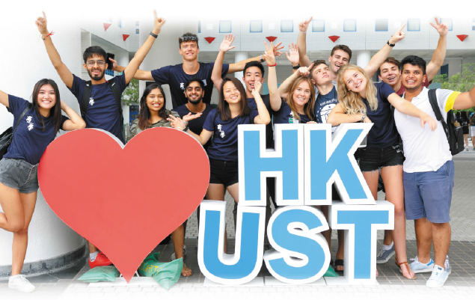
A Diverse Mix of Students
Undergraduate
3,800+
Students
50+
Nationalities
Postgraduate (Including Taught Postgraduate and
Research Postgraduate Students)
1,800+
Students
30+
Nationalities

Slide 12


Strategic Partnerships with Top Business Schools
Extensive Student Exchange Networks
Enrich learning experience and expand network for students
Leading business schools in Asia, Australasia, Europe & North America, such as:
HEC Paris, London Business School, Peking University, Tsinghua, UCLA, University of Sydney, University of Toronto, Yale University
Strong Strategic Partnership for Joint Programs
Create synergies and new opportunities via international partnership
Kellogg-HKUST Executive MBA with Kellogg School of Management, Northwestern University
HKUST-NYU Stern MS in Global Finance with Leonard N. Stern School of Business, New York University
World Bachelor in Business with University of Southern California & Bocconi University
MSc in International Management with CEMS
Bilingual Doctor of Business Administration with Tsinghua University PBC School of Finance
No. of Partners:
UG level
PG level
150+ partners
90+ partners

Slide 13
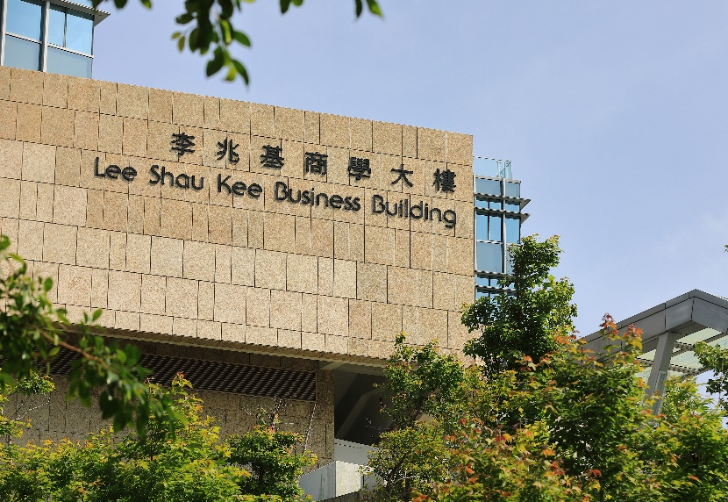



Teaching and Research
Program and Curriculum
Address needs for globalization beyond the region, with a focus on FinTech, Green Finance, Business Analytics, Family Business, and Innovation & Entrepreneurship
Address Asia’s needs and assist regional development
Emphasize on Asian content and perspectives
Pays greater attention than schools in the West to create specialized master’s programs to meet Asian needs for in-depth functional area of expertise
Academic Research and Knowledge Transfer
Enhance our intellectual strengths by continuing our commitment to knowledge creation
Conduct research and develop business case studies that are relevant to the Asian regions

Slide 14

HKUST(Guangzhou)
Focus on cross-disciplinary thematic programs
Academic curriculum designed around four transdisciplinary hubs - Function, Information, Systems, and Society
Opened in September 2022

Slide 15
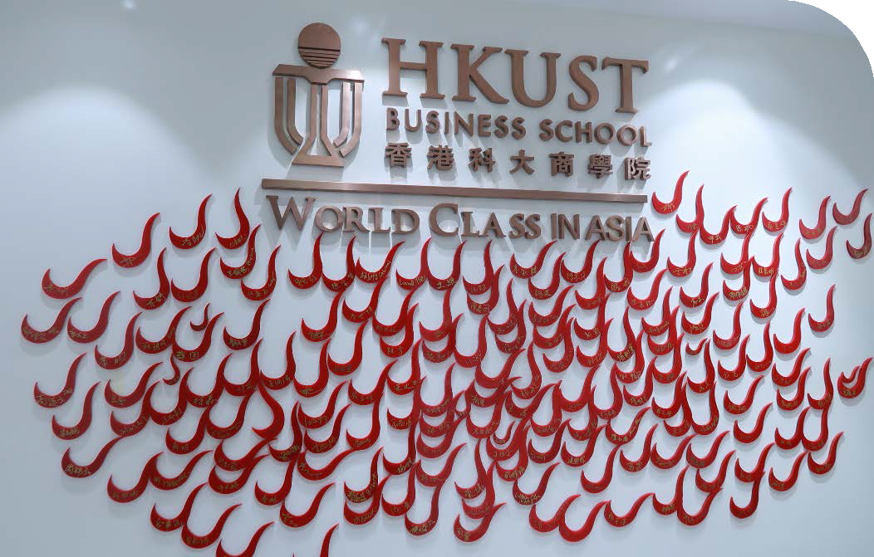
Global Reach & Gateway to CHINA
Programs offered to mainland students/ executives:
Undergraduate programs
Part-time MBA (bi-weekly mode) & Digital MBA for Global Leaders
HKUST Bilingual EMBA
Bilingual Doctor of Business Administration
Non-degree executive education programs & company programs

Slide 16
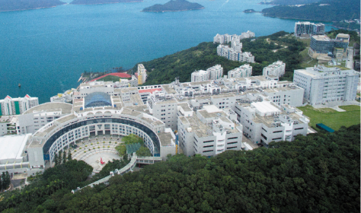
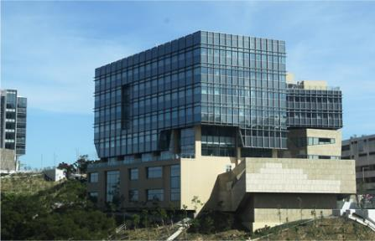
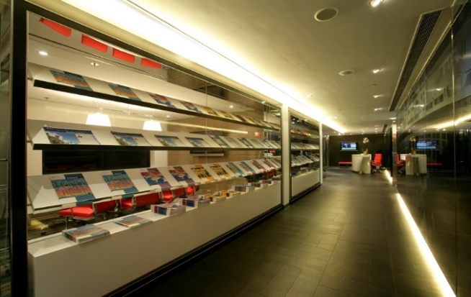
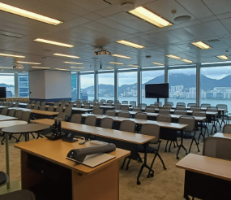
State of the Art Facilities
Beautiful campus with a full range of facilities: classrooms, laboratories, other academic facilities, faculty apartments and student housing, as well as athletic and recreational facilities
Lee Shau Kee Business Building, located atop the HKUST main campus, is home to all of our academic departments and programs
HKUST Business School Central, strategically located in the Hong Kong Club Building in Central, provides students and alumni with a convenient place to meet and interact
MSc Learning Hub in Kowloon East, an extension of the Clearwater Bay campus, enhances all-round educational experience

Slide 17

Prepare LEADERS OF TOMORROW
Strong Subject Knowledge
Critical Thinking Skills
Future Leaders in Global Arena
Sense of Responsibility
Creativity & Innovation
Employment Mobility
Cultural Sensitivity
Global Vision

Slide 18
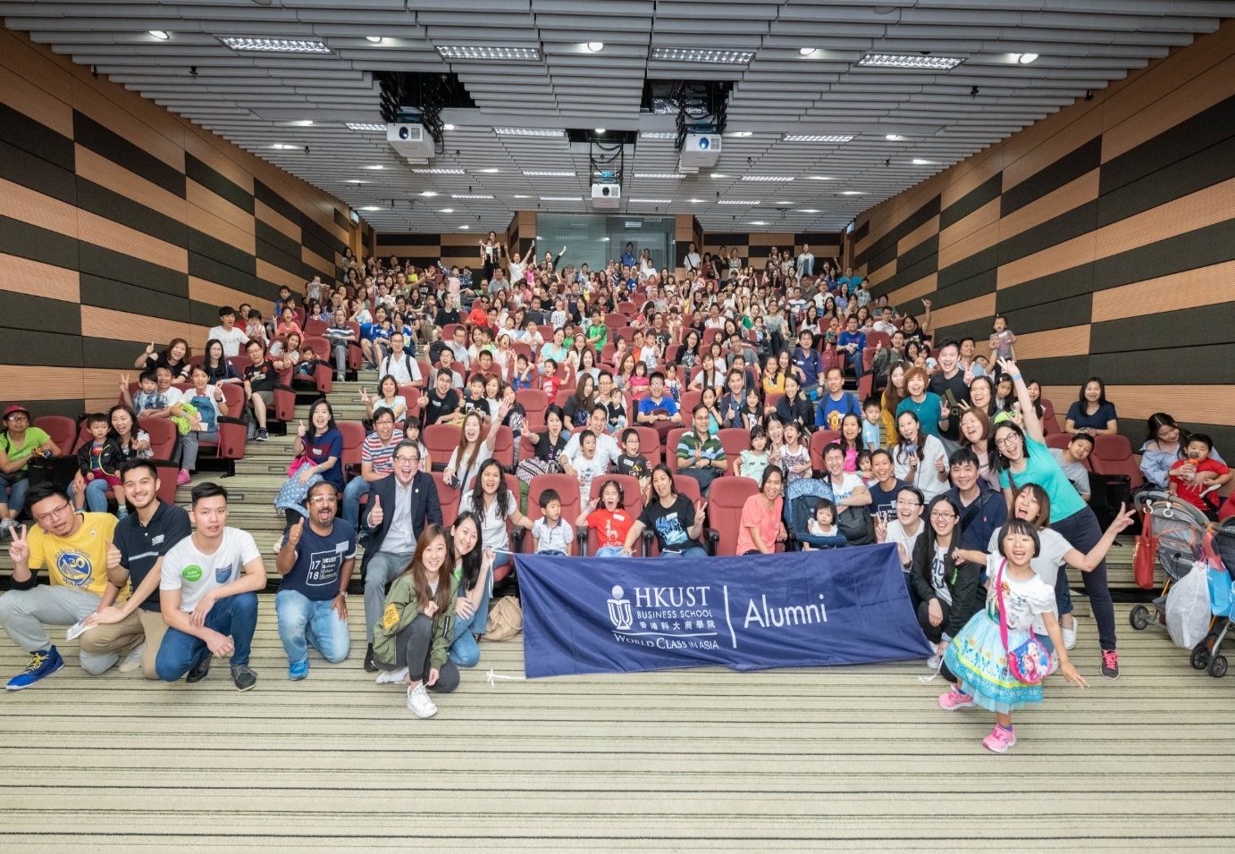
Alumni Network
The School has nurtured 40,000+ business professionals and leaders
Major companies with alumni presence
Representing 100+ nationalities
Including Brunei, Israel, Latvia, Peru, Saudi Arabia, Lebanon, Lithuania, Mauritius, Ecuador, Ukraine, Kuwait, etc.
Located in different regions
Including Chicago, Dubai, Geneva, Manila, New York, Sao Paulo, Seoul, Shanghai, Singapore, Sydney, Tokyo, etc.
AIG/AIA
Bank of America Merrill Lynch
Bank of China
Barclays
BNP Paribas
Cathay Pacific
Citibank
Credit Suisse
DBS
Deloitte
Ernst & Young
Goldman Sachs
HKSAR Government
Hang Seng Bank
HK Monetary Authority
Hospital Authority
HSBC
IBM
JP Morgan
KPMG
Microsoft
Morgan Stanley
MTR
PCCW
PWC
Standard Chartered
UBS

Slide 19
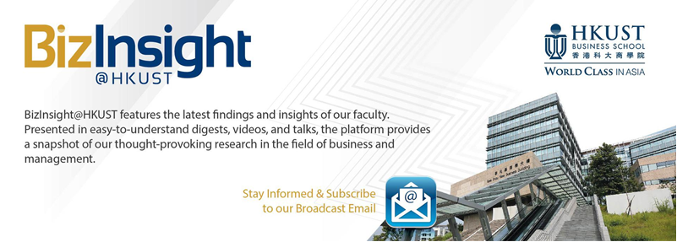




Knowledge Transfer and Community Engagement
Organize Public Seminars and Forums
Influence business policy and practice
To share the latest research findings and promote discussion on topical issues:
Biz@HKUST: School Magazine features topical issues
BizTalks: To share latest research and insights in a friendly language
BizInsight@HKUST: A brand new online platform provides a snapshot of our thought-provoking research and features accessible talks, studies, animated videos, and more
Through contribution of op-ed pieces in major newspapers
Faculty members engage in public services
Hong Kong Committee for Pacific Economic Cooperation, HKMA CBDC Expert Group, Telecommunications Affairs Committee etc

Slide 20

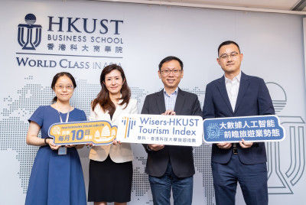

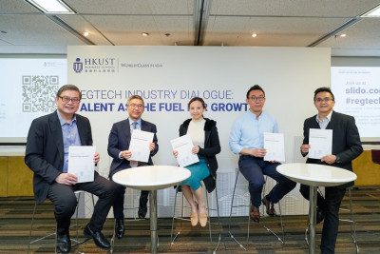

Advance Global Business Knowledge
Research Areas
Wide range of business research areas, including accounting, economics, finance, information systems, business statistics, operations management, management and marketing
Primarily discipline-based, but interdisciplinary research is also promoted
Enhance understanding of business culture and practices in Asia through research and case studies
Publication & Research Seminars
Faculty have continued to contribute intellectually by publishing in top academic journals
The School is active in organizing and participating in academic activities

Slide 21
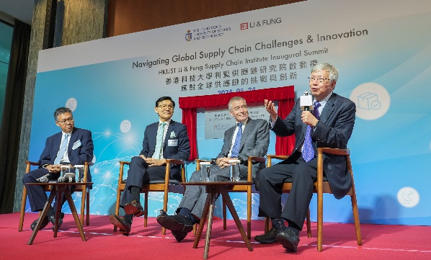
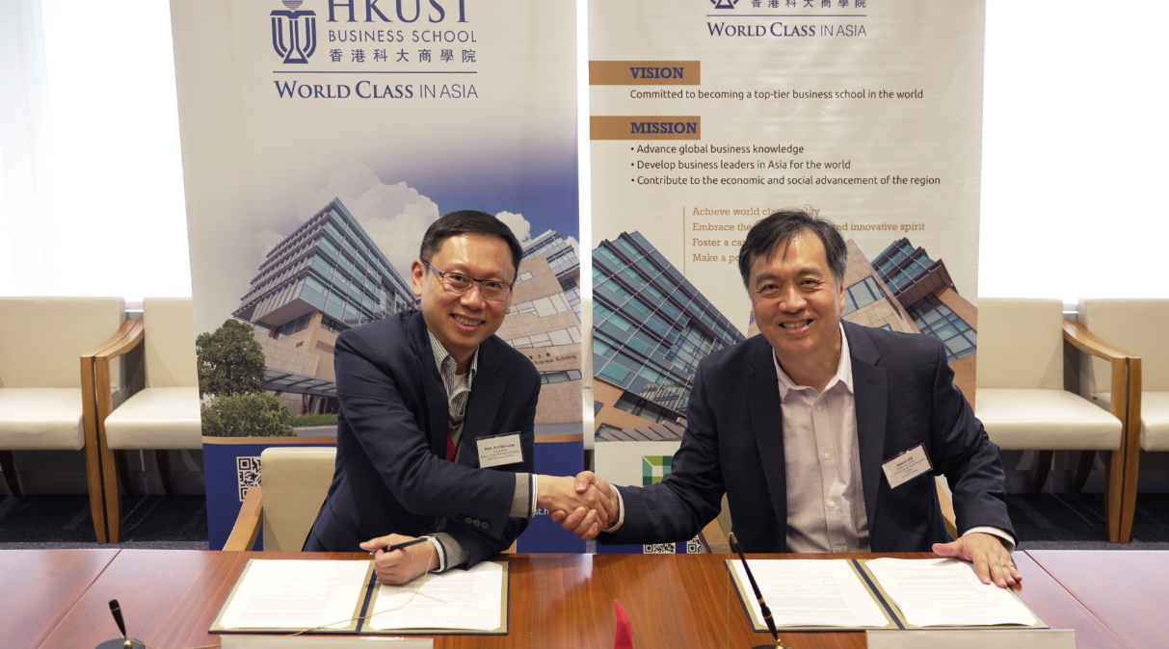
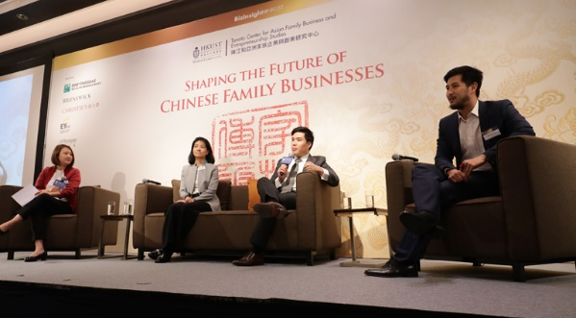
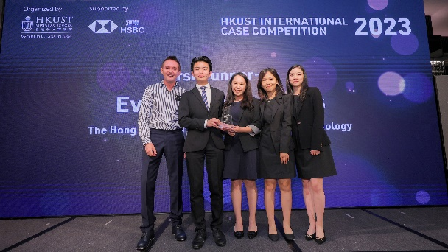
Business & Community Partnership
• School Advisory Council provides strategic advice and support to the School
• The Council consists of local and international business leaders from various industries
• Corporate Projects introduced (since 2008)
• Social Responsibility Projects introduced (since 2007)
• Other programs in collaborations with corporations: case competitions, business competitions, etc.
• Thompson Center for Business Case Studies – partnership with corporations in developing cases
• Roger King Center for Asian Family Business and Family Office – with support of the Roger King Family
Build a strong link with the business sector
Groom future leaders with enhanced learning opportunities
Promote knowledge advancement

Slide 22
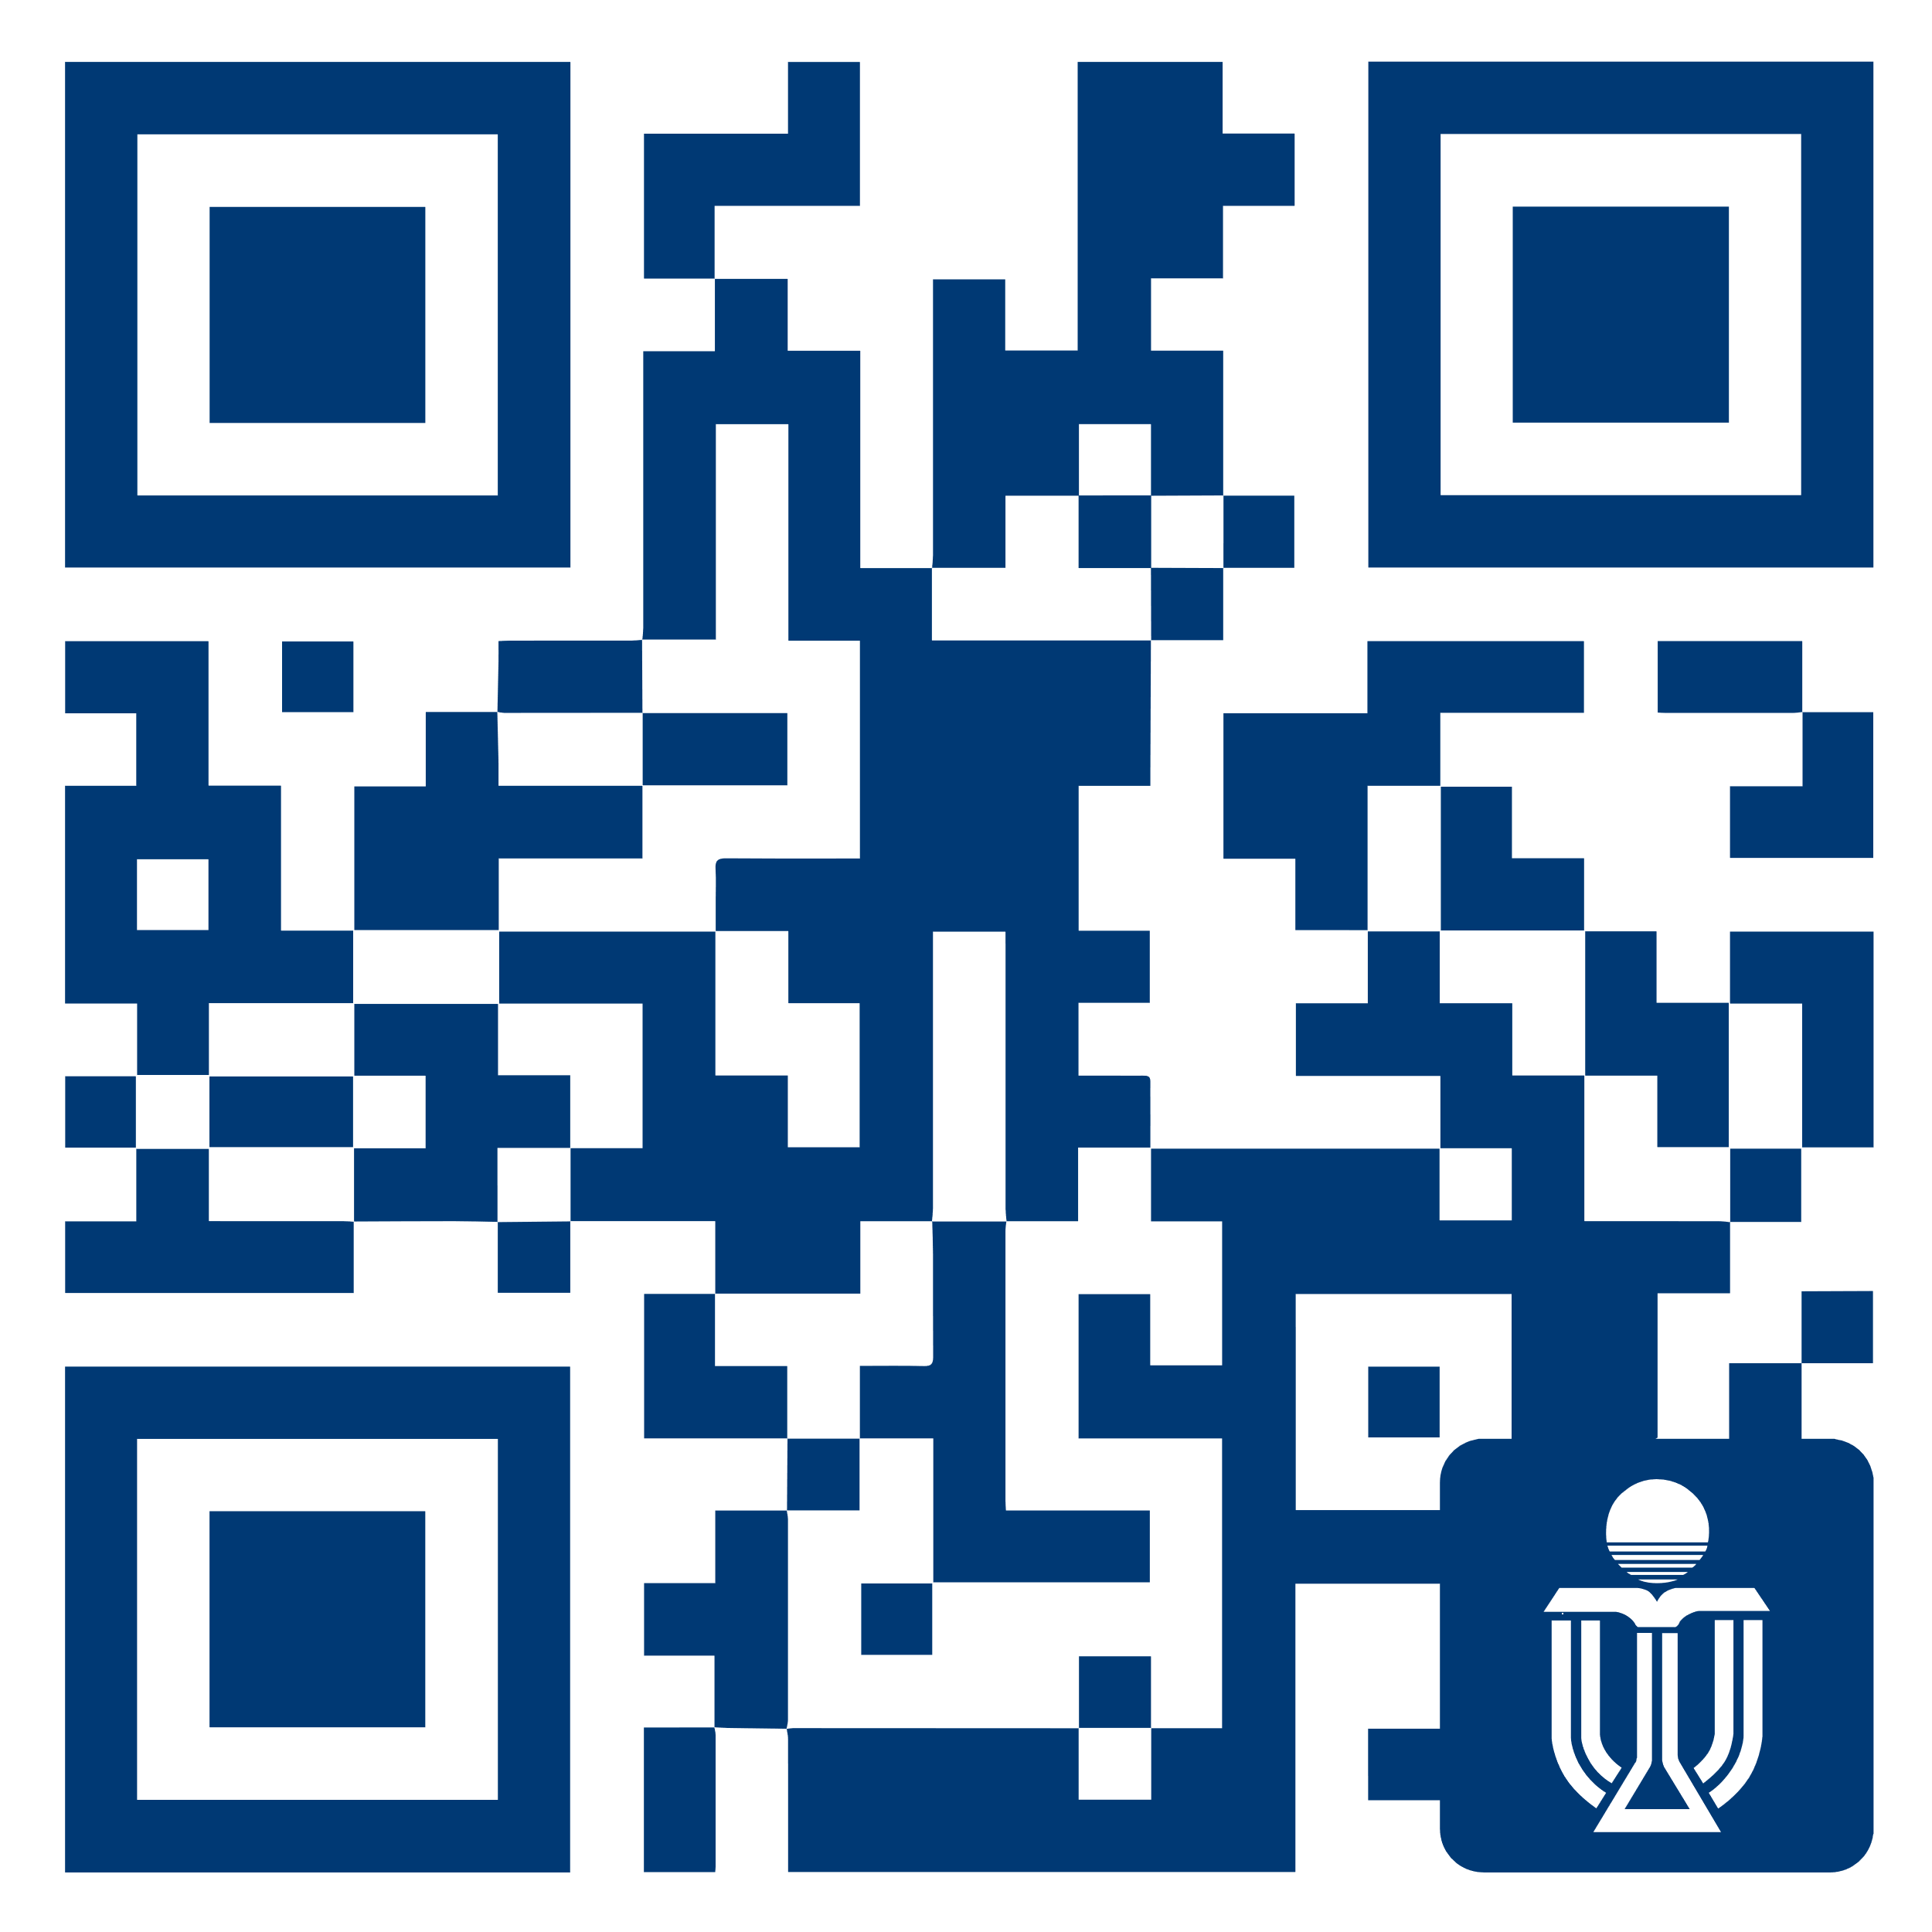





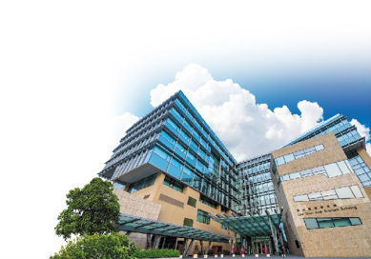
To learn more about us

