Slide 1
Train-the-Trainer Session
Roger
2019-11-14

Slide 2
Outlines
Basics and Logistics for running classes for remaining of the term
Training and Support
Zoom and Webinar Sign up and Subscription
Training materials for Zoom and for Webinar
Suggested Settings for Webinar for our case
Recording of classes conducted on Webinar and sharing to students
Support and Q&A

Slide 3
Basics and Logistics for running classes for remaining of the term
All classes are cancelled this week until Nov 17.
Classes are expected to be resumed on Nov 18 following the same time table.
  Classes conducted live using Webinar: Only difference is that all venues will be online live at webinar
  Classes replaced by recorded video: No class but just lecture videos posted online.
  Any other arrangement decided by the instructors of the course
Final Exam:
  Work with UG coordinators or School Asso Deans if needed
  Do not switch grading to P/F, except perhaps for exchange-in students
  Not part of this training. Discuss separately
Bottom line: students do not need to be physically present on campus

Slide 4
Training and Support
Need to train up around 500-600 colleagues teaching this term in 2 days!!
  Need your help and co-operations!
Thursday 11am: Train-the-Trainers for School-level Reps (Each school about 2-3 faculty members)
Thursday afternoon or Friday morning: Trained colleagues (from Thurs 11am session) will conduct session to Depts’ reps
  At least 2-3 faculty reps per dept
  Run essentially the same session like the one on Thurs 11am
  You may want to invite depts to nominate reps right away
Friday/Sat/Sun: Training sessions for colleagues in each dept/div
  These dept reps run sessions for the faculty members in their Dept
Recording of Thurs 11am training session will be available to the school-level and dept-level training. However, live training session using webinar should still be conducted so that:
  Colleagues can ask questions and get answers right away
  Experience the live session so that they know how students will experience.

Slide 5
Zoom and Webinar Sign up and Subscription
Go to https://zoom.us/signup and use your hkust email address to sign up for an account
  You will get an email to confirm and then sign in to your account.
Go to https://zoom.us/pricing and select ”Pro” by clicking on the orange “Buy Now” button
  Select monthly button and then select Webinar button under the Available Add-ons title
  Select 100 Participant and Monthly button (if you need more than 100 students joining the class simultaneously, select 500 participant option)
  Select ”Do not auto renew button”
  Paid for the total US$54.99 yourselves and University will reimburse you

Slide 6
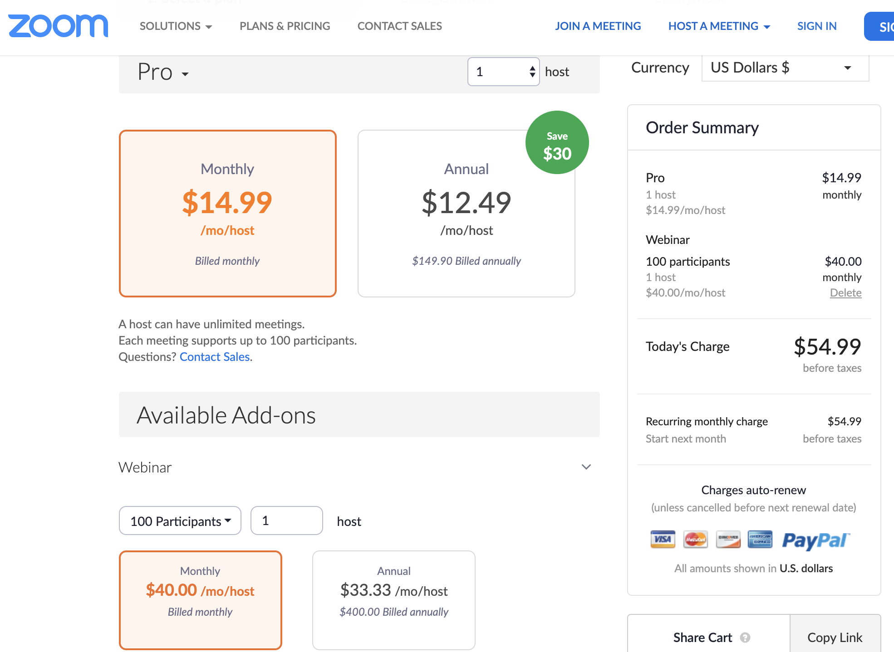
Screen cap for subscription option

Slide 7
Training materials for Zoom and for Webinar
Should be trained for Zoom meeting first
  this can be very convenient for you to have meetings with your colleagues in the next few days when we cannot go to campus, not to mention in the future
Then, get training on Webinar features
  Note that not all webinar features are useful for us
  We will only use selected basic ones so that we can get going
Zoom has training at https://support.zoom.us/hc/en-us/articles/217214286-Watch-Recorded-Training-Sessions

Slide 8
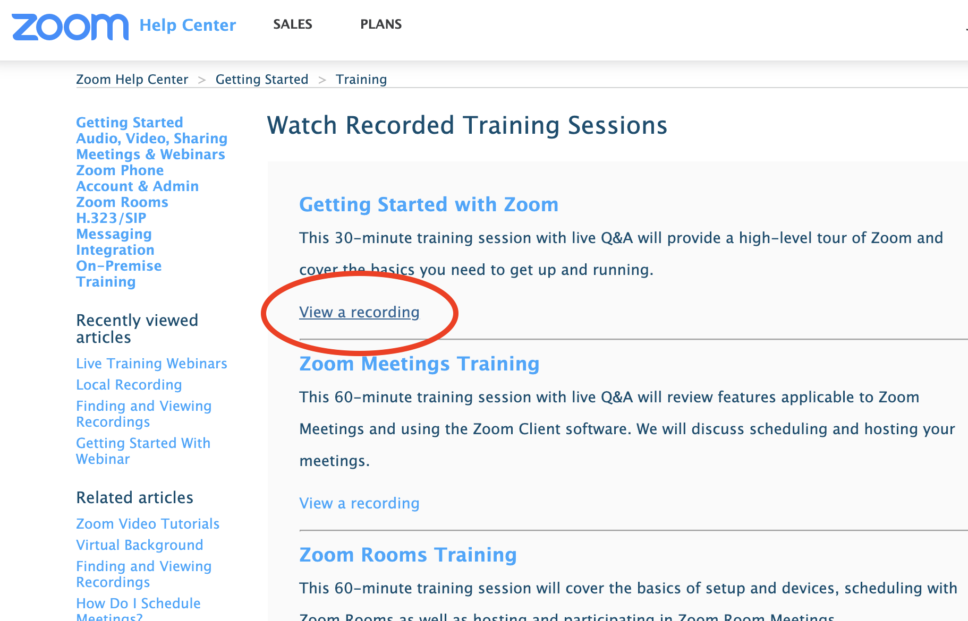
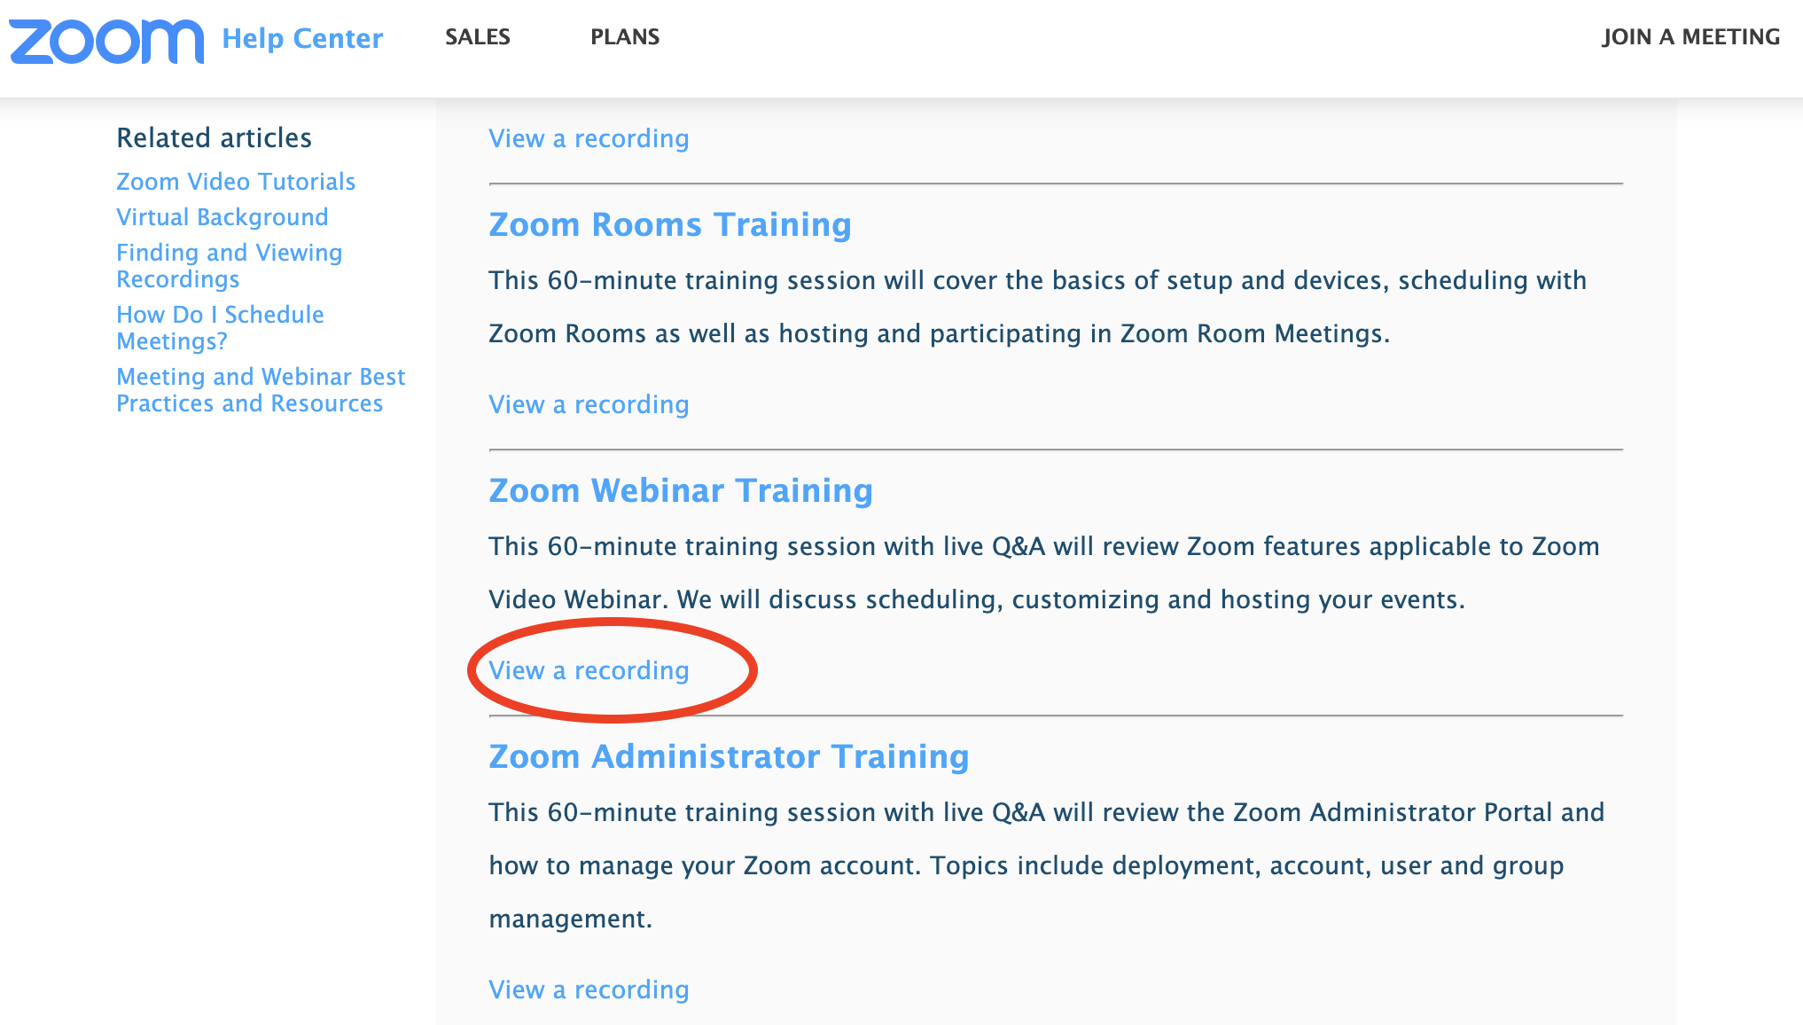
Live and recorded training from Zoom

Slide 9
Recommended Training to use
Strongly recommended:
  Select “View a recording” below the title “Getting started with Zoom”.
  30-min training can be viewed in 1.5x or 2x speed
Then, learn about webinar
  Select ”View a recording” below “Zoom Webinar Training”.
  This 60-min is more than what you need. Basically, you need the following:
    0 to 9:15: Host and Participants status in Webinar (Strongly recommend)
    9:15 to 15:15 Text-based Q&A (May not be needed since students can raise hand to ask question, can learn later if you want to use this features)
    15:15- 18:15 Poll: Nice to have (May not be needed, but can watch)
    18:15 – 22:45 How to Share screen (Absolutely needed, strongly recommended)
    22L:45 – 25:22 Chat and live stream (Suggest to turn off, hence no need to watch)
    25:22 – 29:00 Recording (Strongly Recommend and use cloud recording)
    29:00 – 38:00 Scheduling Webinar (Strongly Recommend and this is how you set up your class)
    38:00 – 39:15 Email notification (No need as we have our email systems)
    39:15 – 40:35 Setting up of Polls (Good features. Nice to have)
    40:35 – 44:00 Marketplace (No need for us)
    44:00 - Sharing of recording (but not for us, since we will simply copy the link and let our students have the link)
    The rest is not for us, can skip the rest.

Slide 10
Recording of classes conducted on Webinar and sharing to students
Suggest to use the automatic Cloud Recording option.
“Pro” status you purchased come with 1 GB storage and a 90 minutes class take ~500MB
Hence, once a class is over, you need to download the video
You can share the video also, but you cannot accumulate too many classes videos in your cloud storage as you have limited storage space. One option is to purchase 100GB storage for US$40/month. We will explore and advice later
We will also find the best way to go forward in solving the storage issue. Will advice later.

Slide 11
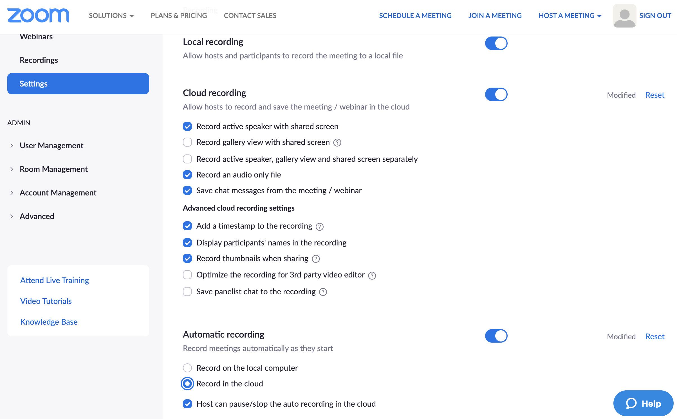
Suggested Settings for Webinar for our case
Will provide a screen capture for the suggested setting under Webinars
However, individual faculty may want to modify it for his/her own preference

Slide 12
Q&A

