Slide 1
Zoom Workshop Session for SBM Faculty

Slide 2
Zoom Discussion Topics
How can Zoom be used to support interactive case discussions in MBA, MSc or UG classes?
How can Zoom be used to support breakout discussions among small groups of students?
Can students use Zoom outside of normal class times for student teams, and if so, how?
Can we use Zoom or other online technologies to support lab sessions without physical labs?
Will using Zoom to replace normal lectures be more work than teaching normal classes?
What resources can SBM provide to assist professors in using Zoom or other online alternatives?
If Zoom does not appear to be an ideal solution for my class, what other options should I consider?

Slide 3
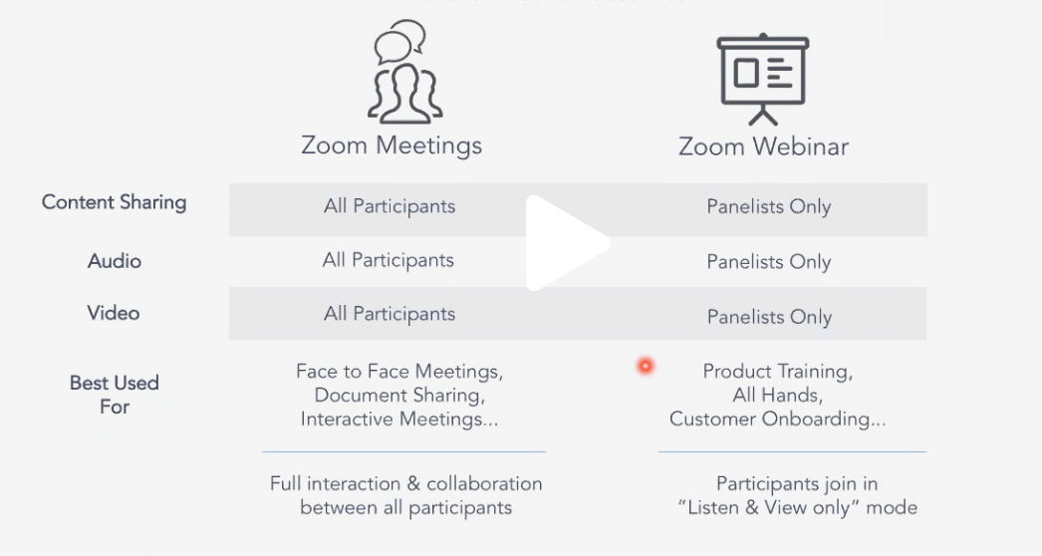
Meeting vs Webinar

Slide 4
Zoom Meeting are Good for…
Class Discussions
Student Presentations
Interactive Q&A
Long Meetings with Discussion
Less than 100 participants

Slide 5
Zoom Webinars are Good for…
Large Groups (More than 50)
One-way communications
Presentations with slides
Some Advanced Features
  Q&A
  Polling
Those with limited bandwidth

Slide 6
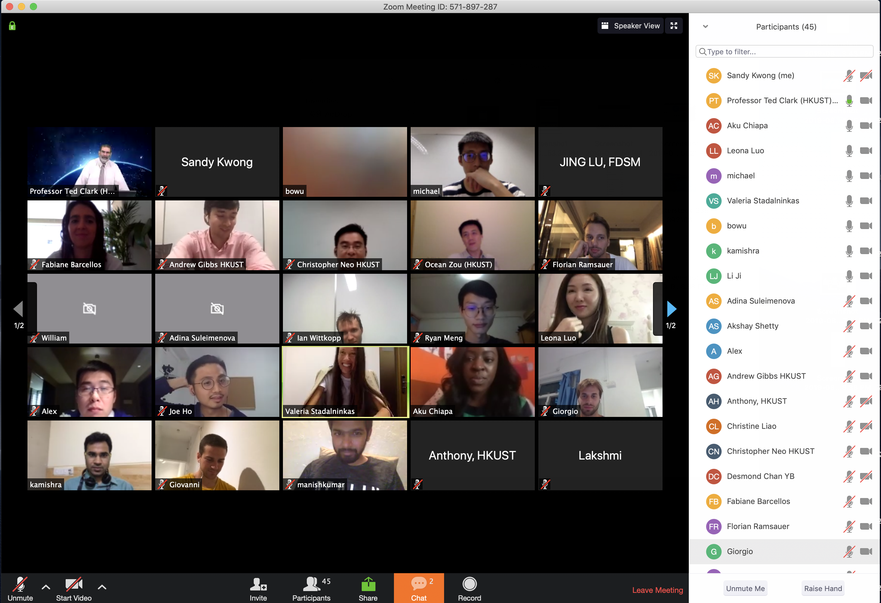
MBA Class on Zoom

Slide 7
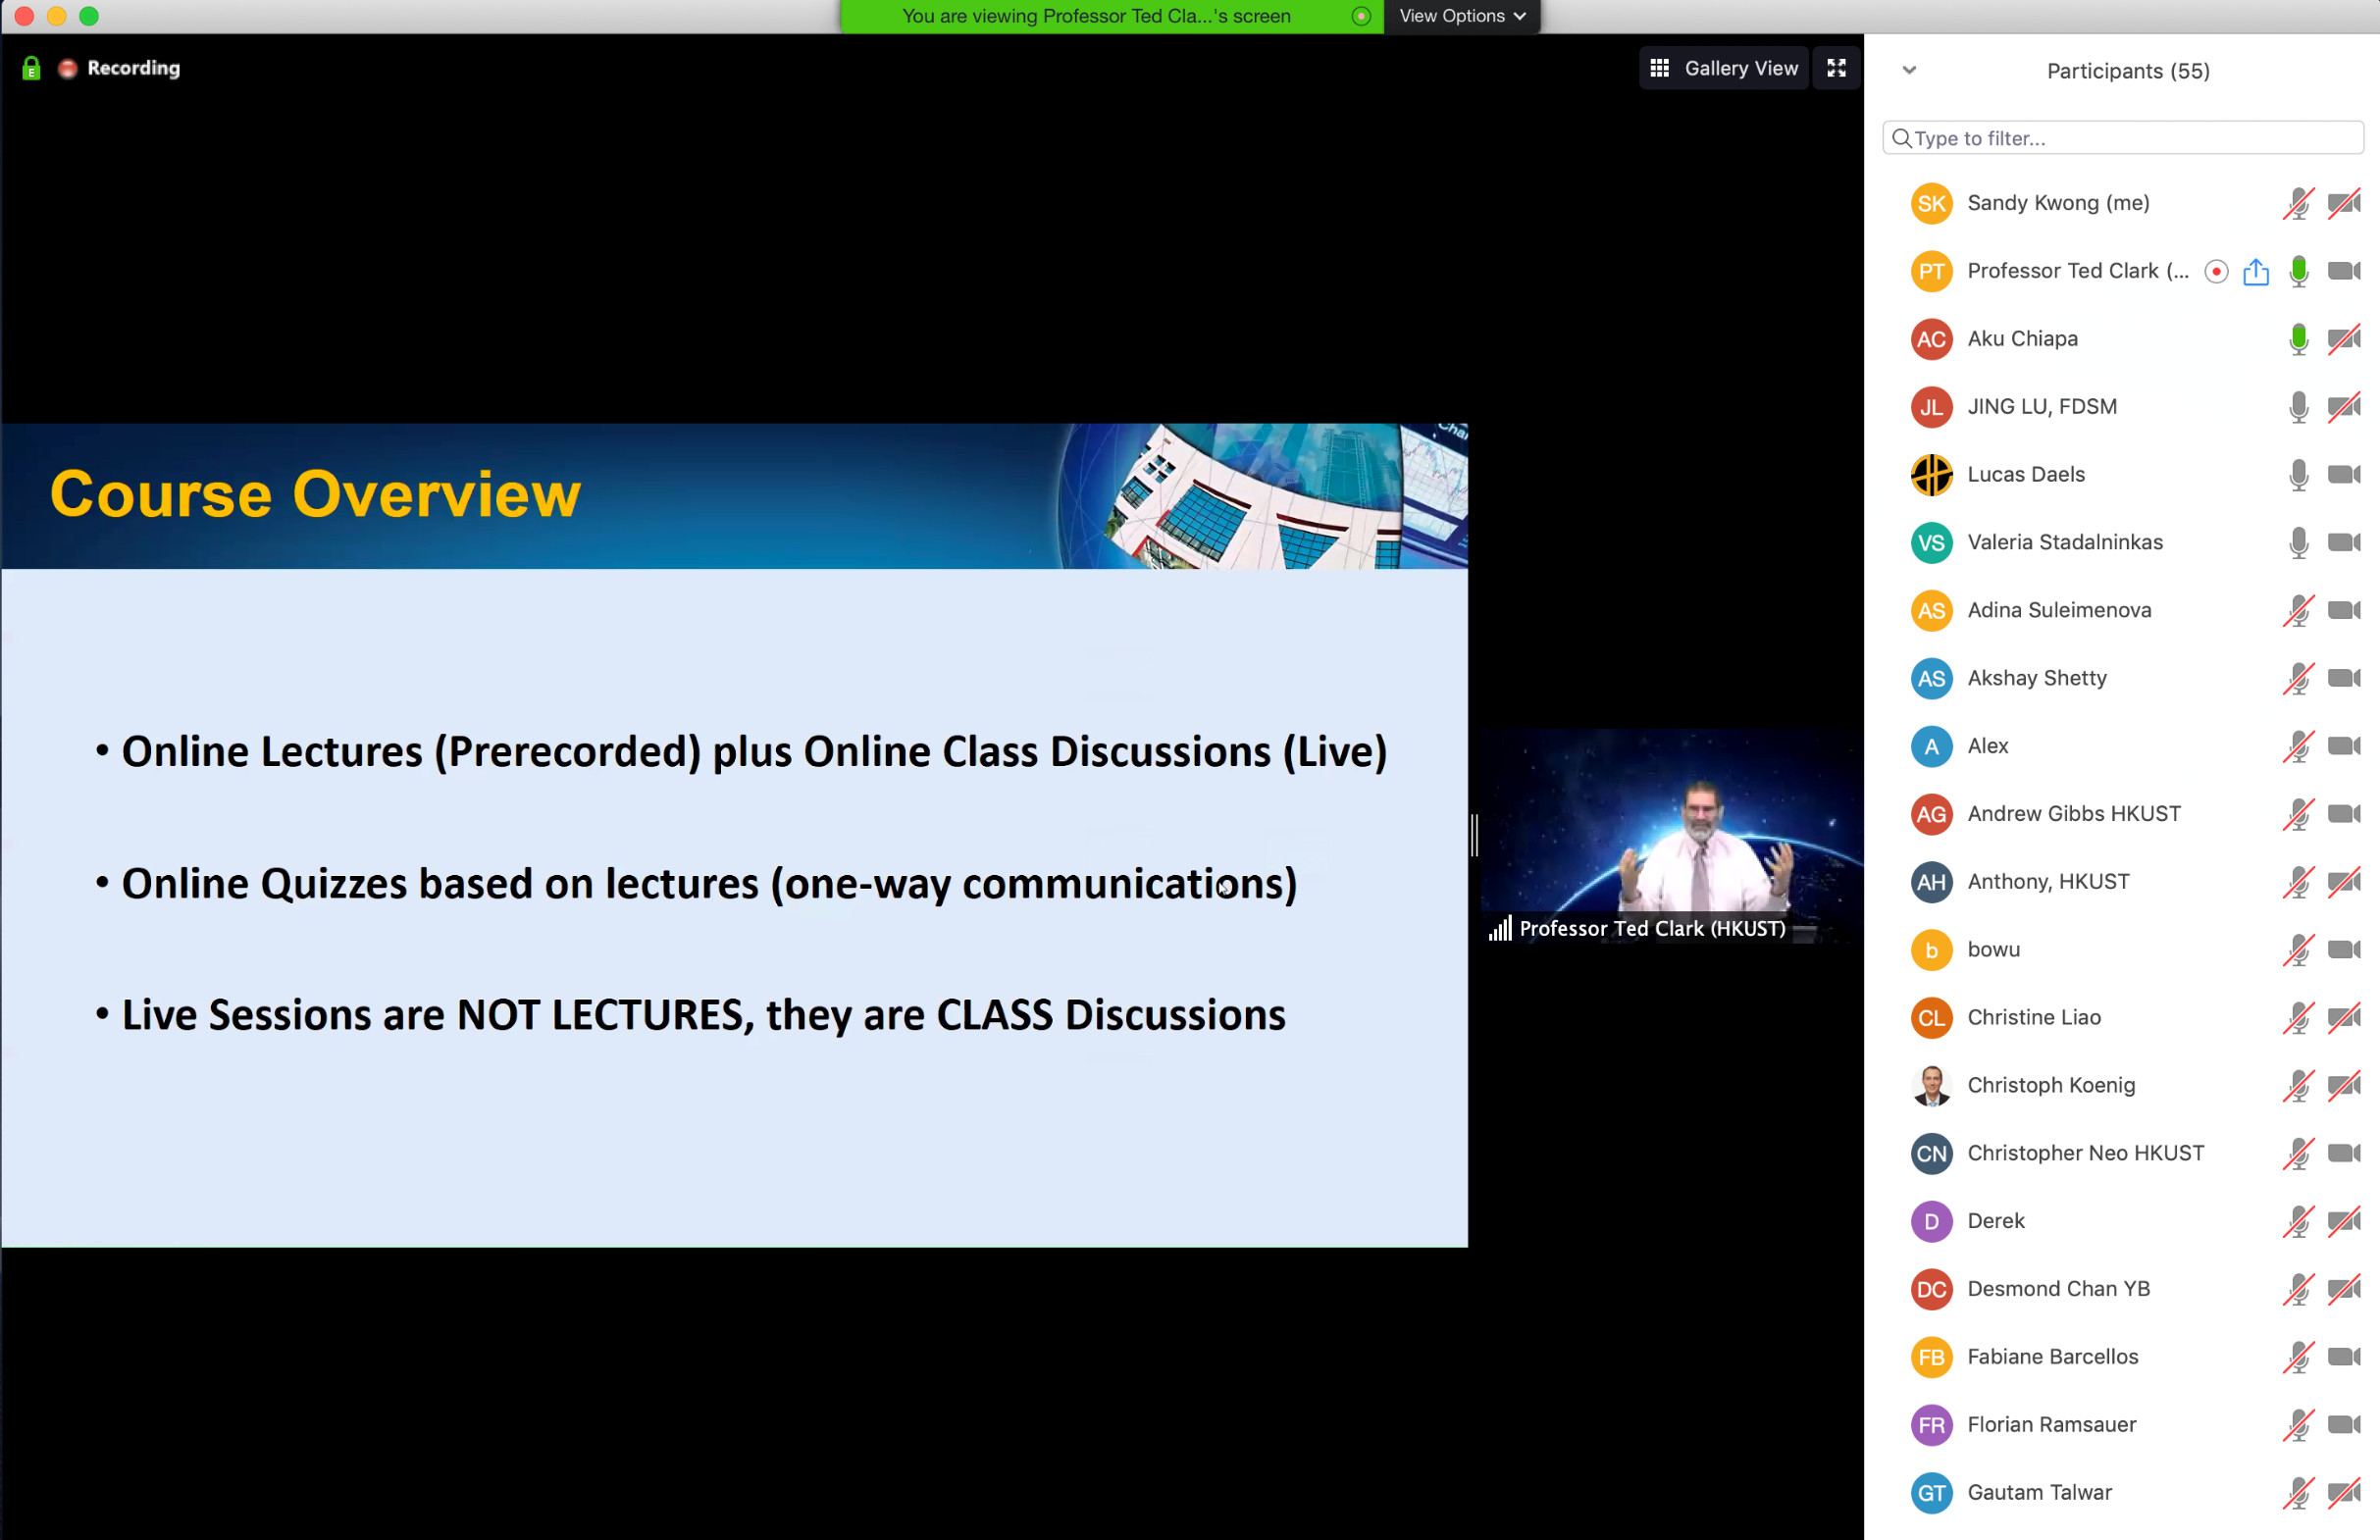
Live Presentations via Zoom

Slide 8
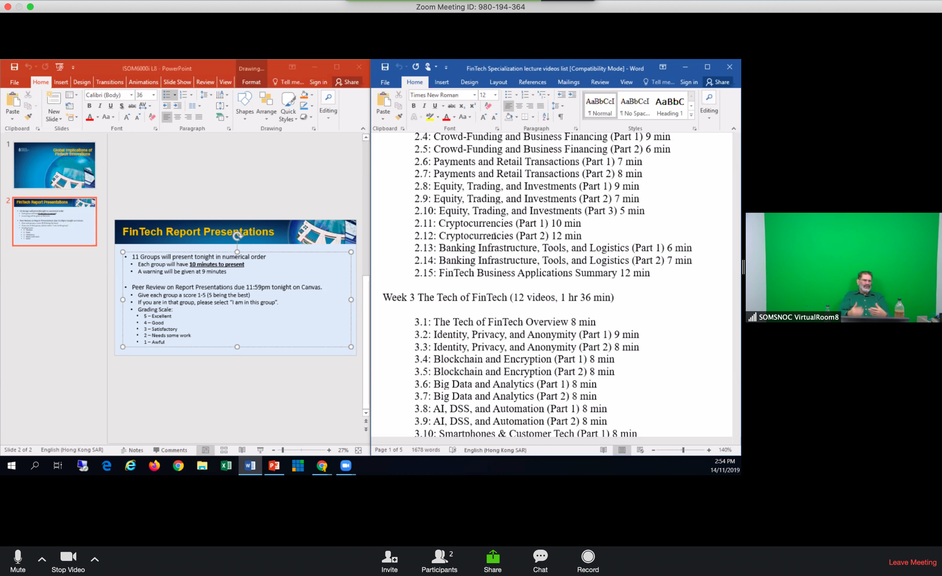
Split Share in Meeting/Webinar

Slide 9
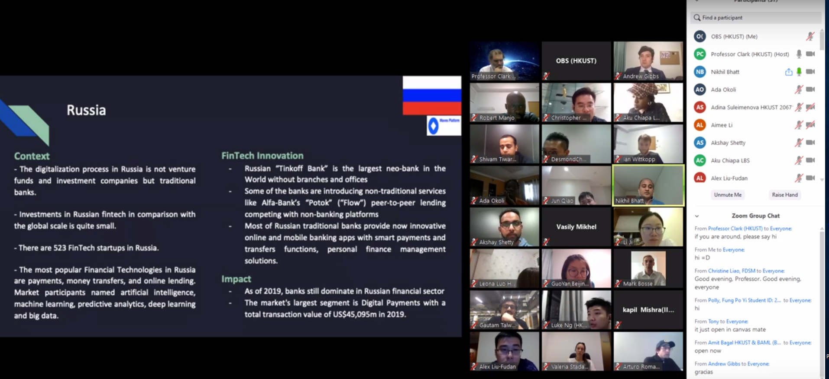
Student Presentation in Meeting

Slide 10
F2F + Zoom Discussion Topics
Current problems with F2F + Zoom teaching
Technical solutions to help in the classroom
Process solutions to improve mixed mode teaching
Discussion of challenges and implications for future

Slide 11
How to setup F2F + Zoom class
This only works in SBM tiered classrooms on G/F, 1/F, and 2/F.
5 classroom (G001, G003, 1005, 2001, and 2003) were modified and connected wireless room mics to podium PC audio input to Zoom.
Suggest to host Zoom meeting on podium PC using wireless room mics for Zoom and classroom.
Make TA co-host of the meeting in case anything goes wrong and host has to restart.
All laptop, tablet, webcam or smartphone must be muted if join Zoom meeting in classroom
Pass handheld wireless mic to students in F2F class when they are speaking so students on Zoom can hear them.

Slide 12
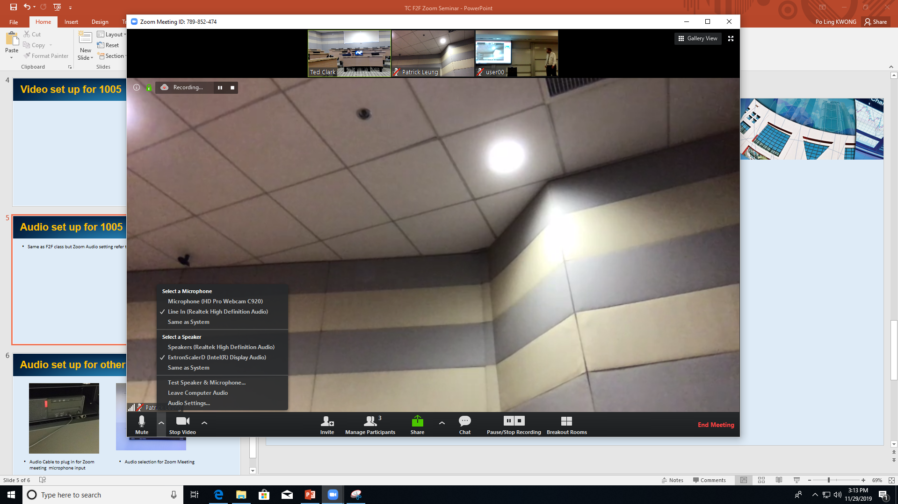
Audio setting on Zoom up
Same as F2F class using wireless mic for classroom but Zoom audio setting refer to this picture

Slide 13
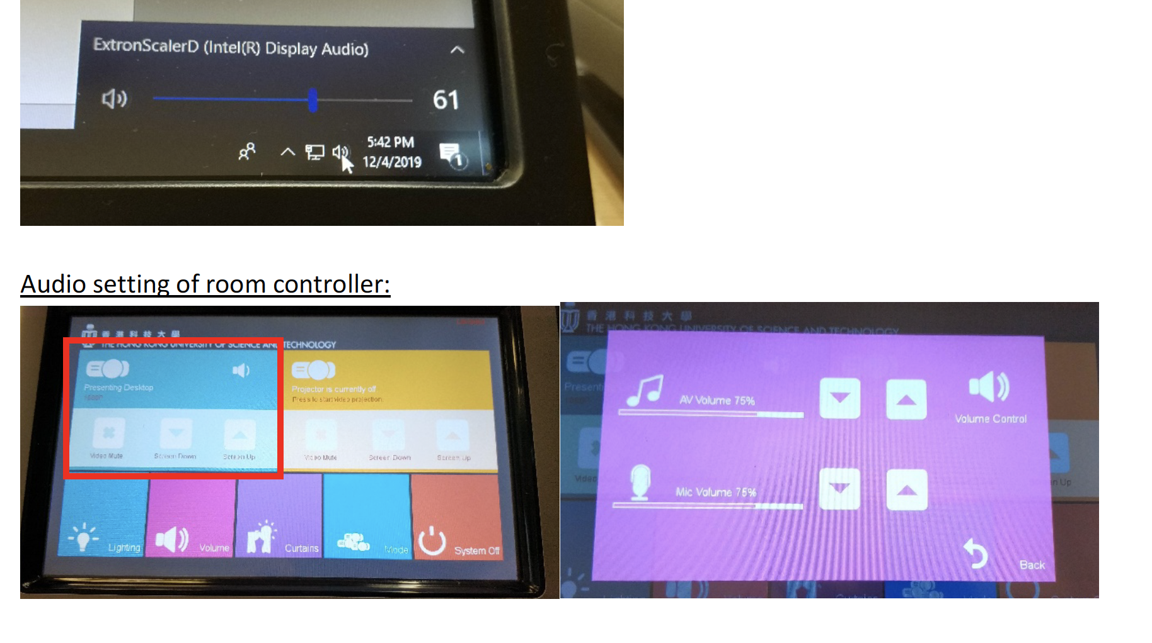
Audio setting on Podium PC & controller
Audio setting on PC
Audio settings on room controller

